Slide 1
CSC4780 – COMPUTER Networks and Security
Instructor: Susmit Shannigrahi
Hash Functions, Merkle Tree
sshannigrahi@tntech.edu

Slide 2
Hash Functions
Any function that can be used to map data of arbitrary size to fixed-size values
Input - is called the seed, and is public.
Output is called the hash value (or message digest)

Slide 3
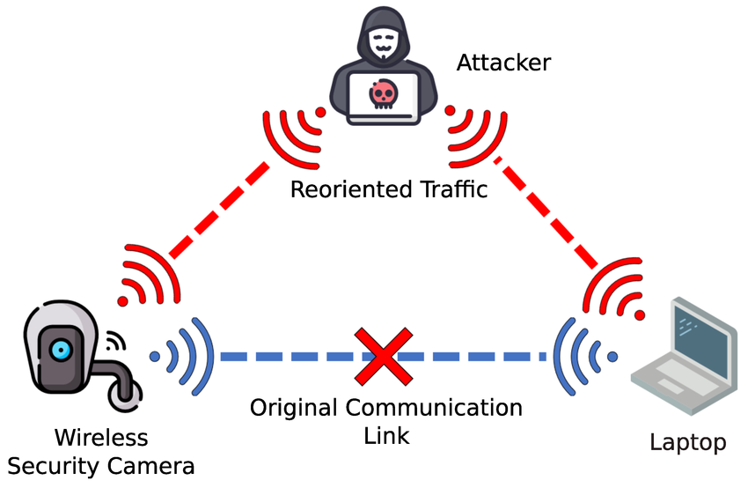
Motivation
Data integrity over networks
How detect modification of a file?
Idea: compute a fingerprint of data

Slide 4
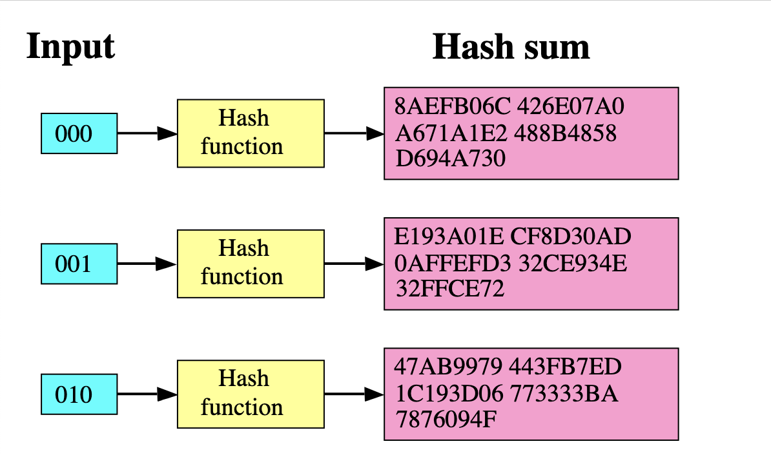
Avalanche Effect
Small input change → large output change
Example:
SHA256('hello') vs SHA256('Hello')

Slide 5
Real-world Failure
MD5 used for certificates
Researchers created fake certificate using collisions
Broken hash → broken security

Slide 6
Birthday Paradox
How many people needed for shared birthday?
≈23 people → 50% probability
Surprisingly small

Slide 7
Idea
Question: In a group of people, what is the chance two share the same birthday?
Instead of computing this directly, compute the opposite:
Probability that everyone has different birthdays.
1st person: 365/365
2nd person: 364/365
3rd person: 363/365
... continue multiplying
P(no shared birthday) ≈ 0.49 for 23 people
So P(shared birthday) = 1 − 0.49 ≈ 0.51

Slide 8
Key Result
With only 23 people,
there is about a 50% chance that two people share a birthday.
This surprising result explains why
hash collisions appear much earlier than expected.

Slide 9
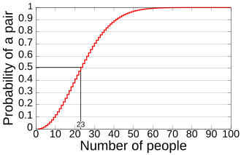
Birthday Math
For N possible outputs
Probability ≈ q² / (2N)
Collision when q ≈ √N

Slide 10
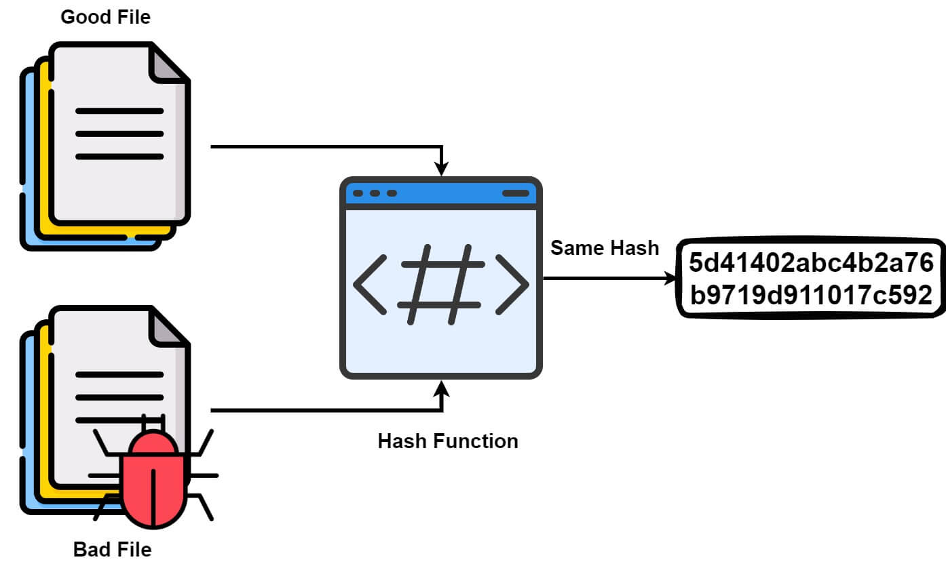
Birthday Attack on Hashes
n-bit hash → N = 2ⁿ outputs
Collision complexity ≈ 2^(n/2)
Example: SHA‑256 → 2^128 work
Many different inputs are hashed.
Eventually two inputs produce the same hash.
Instead of attacking one hash, the attacker compares many hashes with each other.
Message A (harmless)
Message B (malicious)
Sign(H(A)), attacker replaces with H(B)

Slide 11
Definition of Hash Function
H : {0,1}* → {0,1}ⁿ
Arbitrary length input
Fixed length output

Slide 12
Timeline
1990 MD4
1992 MD5
1995 SHA-1
2001 SHA-2
2015 SHA-3

Slide 13
Security Status
MD5 -> Broken (collisions)
SHA-1 -> Broken (collisions)
SHA-2 -> Secure
SHA-3 -> Secure

Slide 14
Security Properties
Preimage resistance
Given a hash value H(x), it should be hard to find any input x that produces it.
Second-preimage resistance
Given an input x, it should be hard to find a different input x′ with the same hash.
Collision resistance
It should be hard to find any two different inputs x and y such that H(x) = H(y).

Slide 15
Ideal Hash Function:
Truly random function
This (idealized, theoretical model) is called the Random Oracle Model (ROM)
Many cryptographic primitives use hash functions, and often security is proved in the ROM.
Truly
Random
unless previously queried, in which case consistent with previous answer
x
Notes:
The ROM is a theoretical model that is not achievable in practice.
It models the hash function as an oracle (i.e., black box) that on any input outputs a truly random value in denoted by unless the query was already sent, in which case the oracle replies consistently. (The oracle stores all its queries.)

Slide 16
Ideal Hash Function:
In practice, use SHA256
Real hash functions (SHA-256, SHA-3) are not true random oracles, but they are designed to behave similarly.
Truly
Random
unless previously queried, in which case consistent with previous answer
x
Notes:
SHA 256 is NOT a random oracle, but hopefully it is “pseudo-random enough” that an adversary cannot exploit any flaws in it.

Slide 17
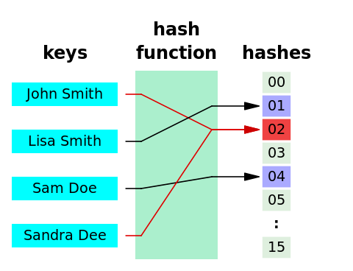
Desired Properties
One-Way
Collision Resistant

Slide 18
Security Requirements for Cryptographic Hash Functions
Given a function h(X) →Y,
one-way:
Given a hash value y, it should be hard to find any input x such that h(x) = y.
weak collision resistant (second-preimage)
Given an input x, it should be hard to find a different input x′ such that h(x′) = h(x).
strong collision resistant (collision resistance)
It should be hard to find any two different inputs x and x′ such that h(x) = h(x′).
Notes:
18

Slide 19
Usage of Hash Functions?
Authentication - how do you ensure a password is really in a database?
User enters password P' Compute H(P') Compare with stored H(P) If equal → authentication succeeds
In practice, needs salts
Prevents identical passwords having identical hashes

Slide 20
Merkle Hash Tree for Data Authentication
Construct a binary tree where each leaf corresponds to a piece of data
Each internal node is hash of two children
Authenticate the root using some method
A leaf node along with the sibling node of each node to the path suffices to authenticate the node
Needs log(n) computation to authenticate any node

Slide 21
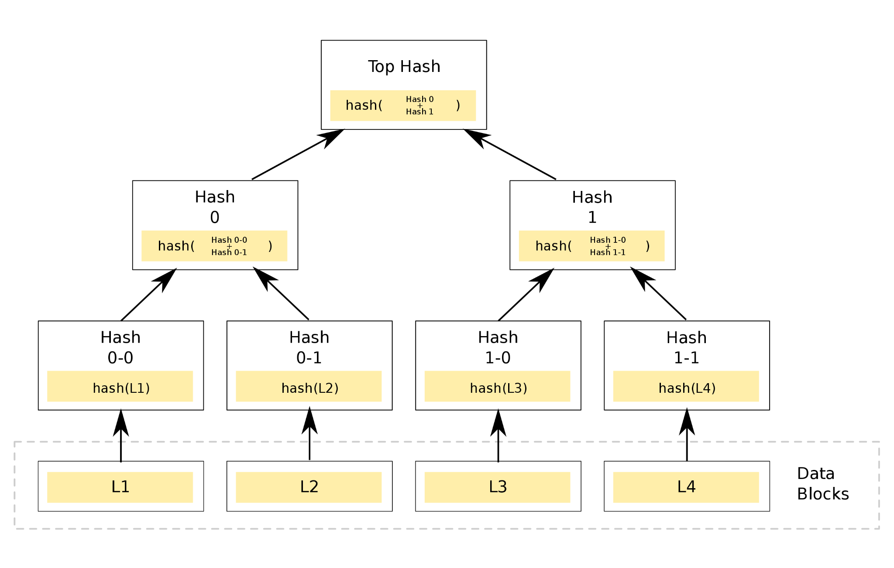
Merkle Hash Tree for Data Authentication
https://commons.wikimedia.org/wiki/File:MerkleTree2.svg#/media/File:MerkleTree2.svg

Slide 22
Structure
Each data block is hashed
Neighbor hashes are combined and hashed again
This process continues until one hash remains (root hash)
Example:
H(D1), H(D2), H(D3), H(D4)
H(H(D1)||H(D2)), H(H(D3)||H(D4))
Root hash

Slide 23
Authentication
To verify a data block, only a few hashes are needed.
Example: verify D1
Need: D1, H(D2), H(H(D3)||H(D4))
Verification cost: O(log n)

Slide 24
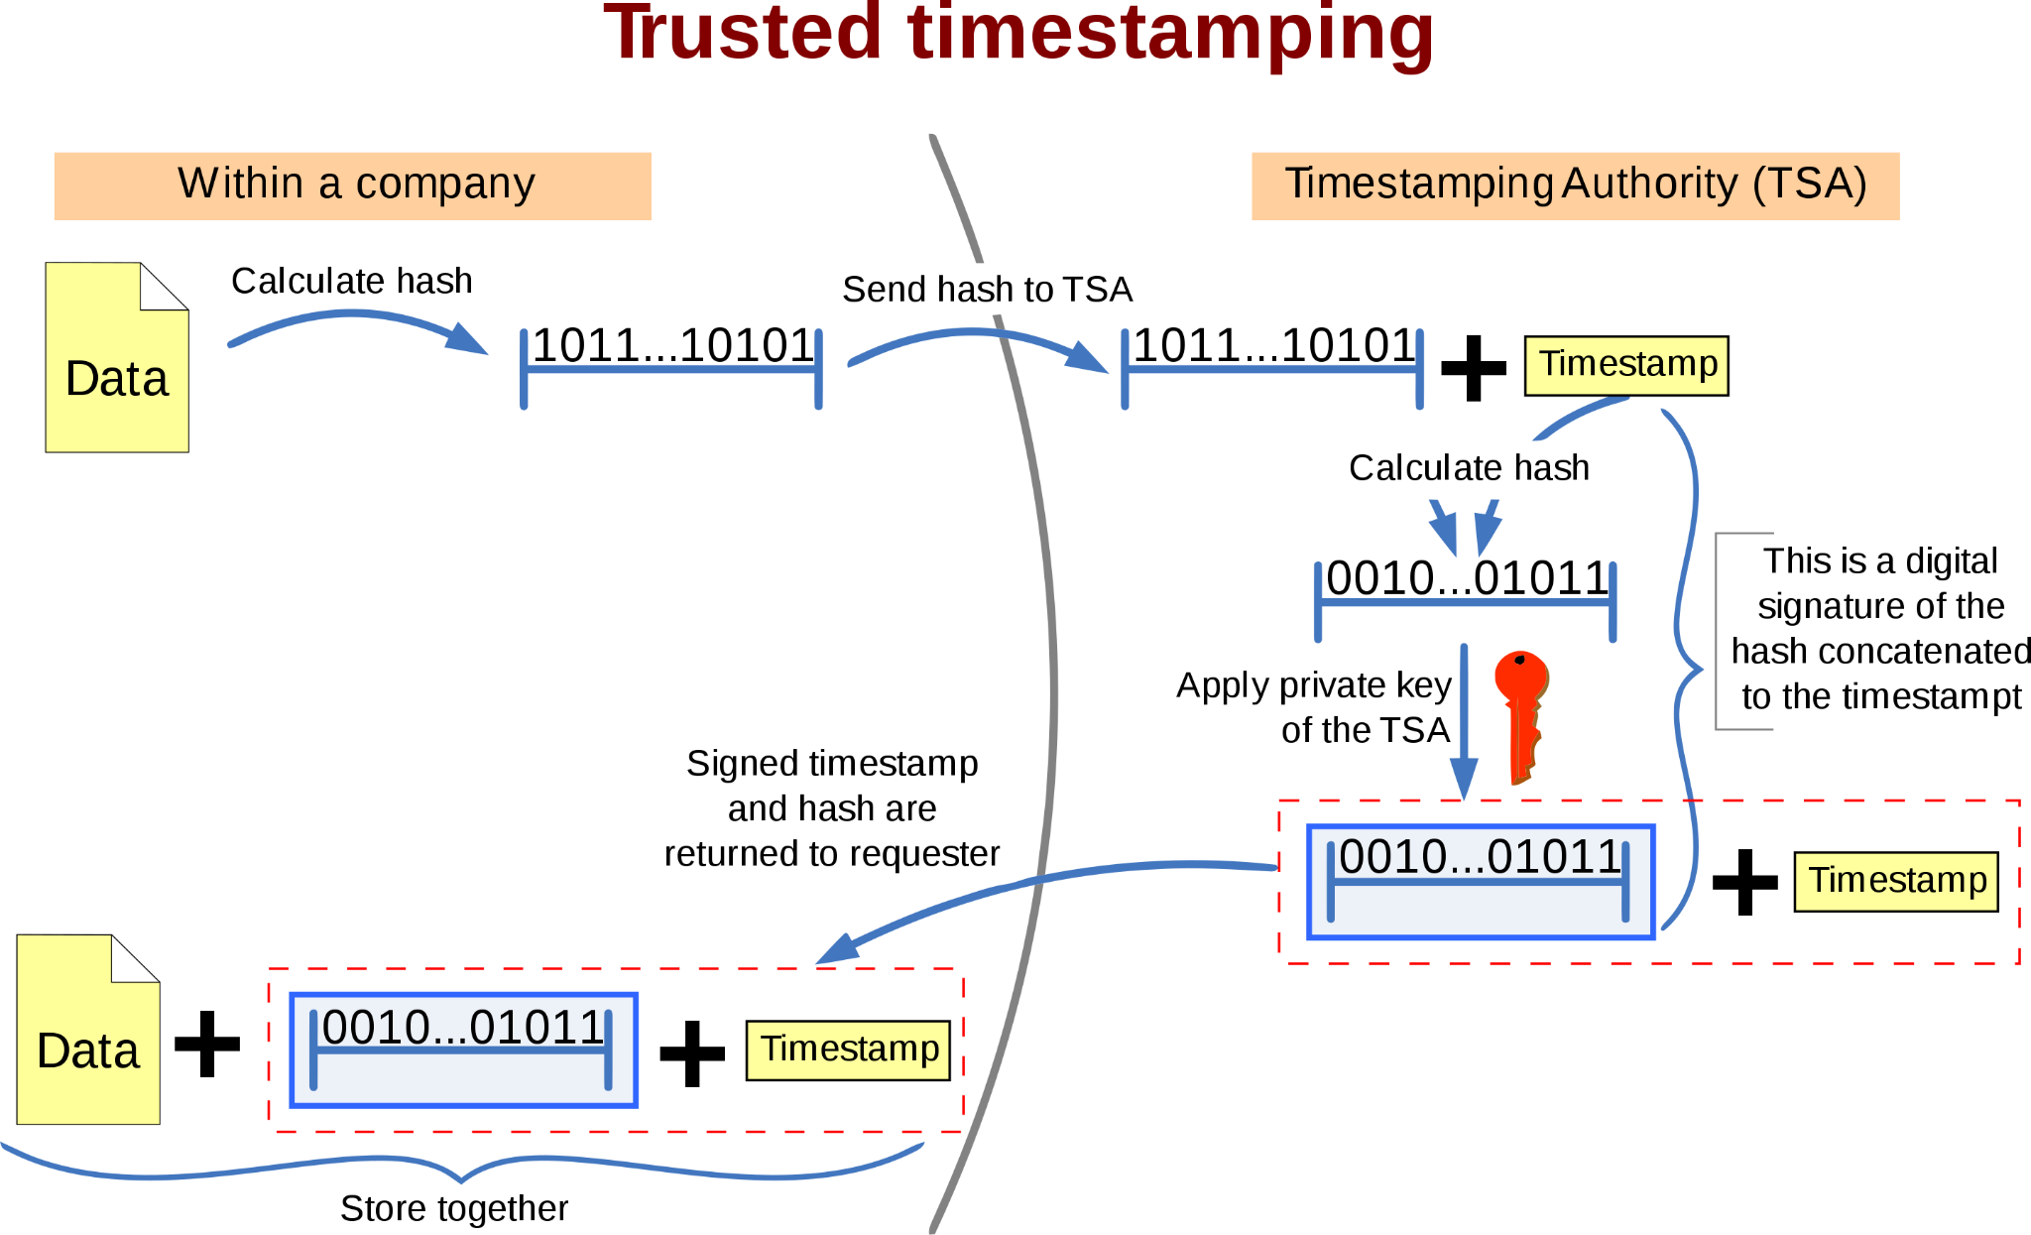
Usages of Cryptographic Hash Functions
Software integrity
E.g., tripwire
Timestamping (cryptographic commitment)
Authenticating logs (a long history of events)
Covered later
Message authentication
One-time passwords
Digital signature
Notes:
24

Slide 25
Bruteforce Attacks on Hash Functions
Attacking one-wayness
Goal: given h:X→Y, y∈Y, find x such that h(x)=y
Algorithm:
pick a random value x in X, check if h(x)=y, if h(x)=y, returns x; otherwise iterate
after failing q iterations, return fail
If the hash output is m bits
To get about a 50% chance of success
q ≈ 2^(m−1)
128-bit hash → about 2^127 attempts
256-bit hash → about 2^255 attempts
https://www.cs.purdue.edu/homes/ninghui/courses/526_Fall15/handouts/15_526_topic04.ppt
Notes:
25

Slide 26
Parameters
Collision resistance of a hash function that outputs n bits, is about n/2 bits
i.e., it takes 2^{n/2} time to bruteforce it
Assuming that no better way of attacking the hash function is known
Longer outputs often means more computation time and more communication overhead
Computationally secure

Slide 27
Length of Hash outputs
The Weakest Link Principle:
A system is only as secure as its weakest link.
Hence all links in a system should have similar levels of security.
Because of the birthday attack, the length of hash outputs in general should double the key length of block ciphers:
SHA-256, SHA-384, SHA-512 -> 128,192,256 bit keys in AES
Notes:
Which hash function to use?
27

Slide 28
Well Known Hash Functions
MD5
output 128 bits
collision resistance completely broken by researchers in China in 2004
SHA1
output 160 bits
no collision found yet, but method exist to find collisions in less than 2^80
considered insecure for collision resistance
one-wayness still holds
SHA2 (SHA-224, SHA-256, SHA-384, SHA-512)
outputs 224, 256, 384, and 512 bits, respectively
No real security concerns yet
SHA3 (224, 256, 384, 512)

Slide 29
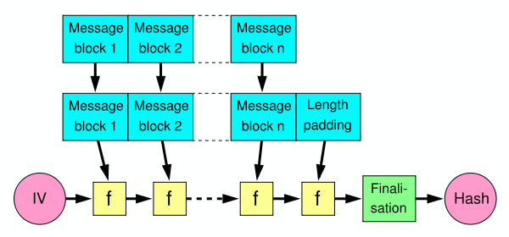
Merkle-Damgård Construction
Build a hash function by repeatedly applying a compression function to message blocks.
Message is divided into fixed-size blocks and padded
Uses a compression function f, which takes a chaining variable (of size of hash output) and a message block, and outputs the next chaining variable
Final chaining variable is the hash value
M=m₁m₂…m_{n}; C₀=IV, C_{i+1}=f(C_{i},m_{i}); H(M)=C_{n}

Slide 30
NIST SHA-3 Competition
The publication of FIPS 202 was released in August 2015. This algorithm was originally called Keccak (pronounced “Ketchak”) and was chosen in an open fashion via the NIST hash function competition, which included 51 round-1 entries.
Designed by Guido Bertoni, Joan Daemen (co-designer of Rijndael/AES), Michael Peeters, and Gilles Van Assche.

Slide 31
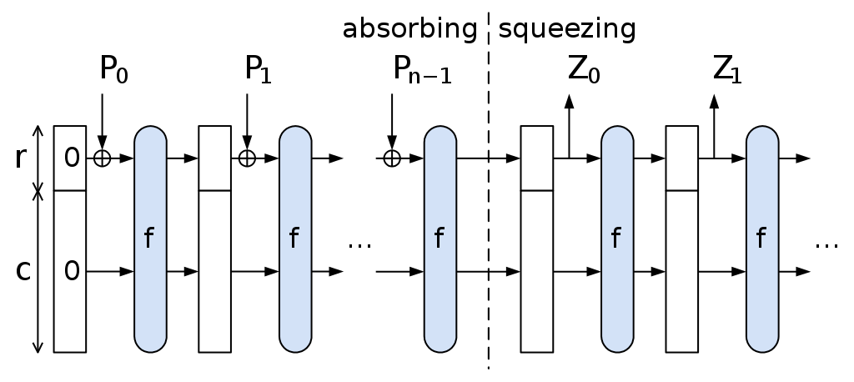
Sponge Function
A state memory, S, containing b bits,
S is initialized to zero
for each r-bit block B of P(string)
R is replaced with R XOR B (using bitwise XOR)
S is replaced by f(S)
The sponge function output is now ready to be produced ("squeezed out") as follows:
repeat
output the R portion of S
S is replaced by f(S) unless output is full
If less than r bits remain to be output, then R will be truncated (only part of R will be output).
Absorb: mix input into state Squeeze: extract hash output Used in SHA-3

Slide 32
Limitation of Using Hash Functions for Authentication
Require an authentic channel to transmit the hash of a message
Without such a channel, it is insecure, because anyone can compute the hash value of any message, as the hash function is public
Such a channel may not always exist
How to address this?
use more than one hash functions
use a key to select which one to use

Slide 33
Message Authentication Code (MAC)
A MAC scheme is a hash family, used for message authentication
MAC(K,M) = H_{K}(M)
The sender and the receiver share secret K
The sender sends (M, H_{k}(M))
The receiver receives (X,Y) and verifies that H_{K}(X)=Y, if so, then accepts the message as from the sender
To be secure, an adversary shouldn’t be able to come up with (X’,Y’) such that H_{K}(X’)=Y’.
MAC: Using a shared secret (or a limit-bandwidth confidential channel) to achieve authenticity/integrity.

Slide 34
HMAC Security
If used with a secure hash functions (e.g., SHA-256) and according to the specification (key size, and use correct output), no known practical attacks against HMAC

Slide 35
Password Storage
Store H(password)
User login → hash input → compare
Use salt and slow hashes (bcrypt, Argon2)

Slide 36
Digital Signatures
Hash message
Sign hash instead of full message
Faster and secure

Slide 37
Hash Chains
Repeated hashing
H(H(H(x)))
Used for one-time passwords and commitments

Slide 38
Blockchain
Block contains previous hash
Blocks linked using hashes
Tampering breaks chain

Slide 39
Modern Hash Algorithms
SHA‑256
SHA‑3
BLAKE2

Slide 40
Reading
* https://icmconference.org/wp-content/uploads/A23b-Powers.pdf * https://www.cs.purdue.edu/homes/ninghui/courses/526_Fall15/handouts/15_526_topic04.ppt * Chapter 5 of Kuffman

